Slide 1
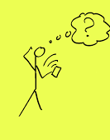
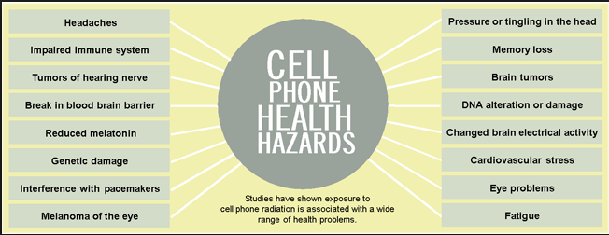
Is your cellphone bad for your health????

Slide 2
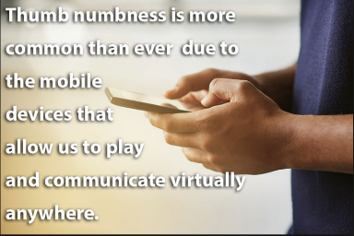
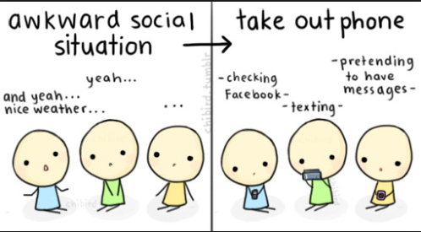
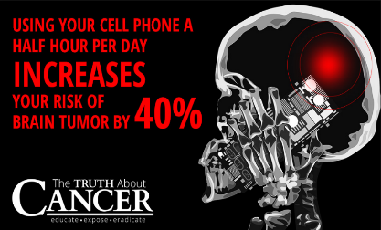

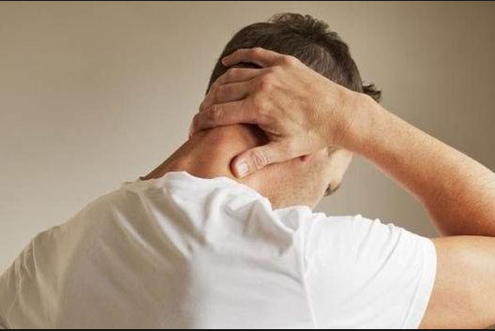
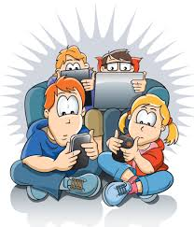



Slide 3

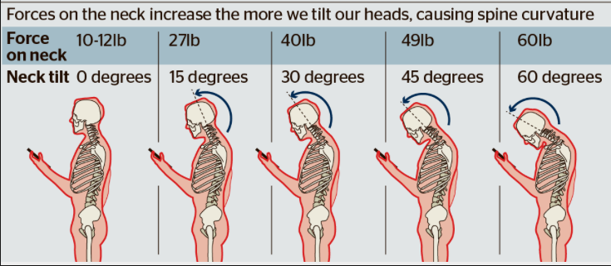
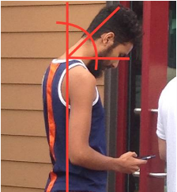


Slide 4
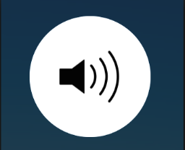
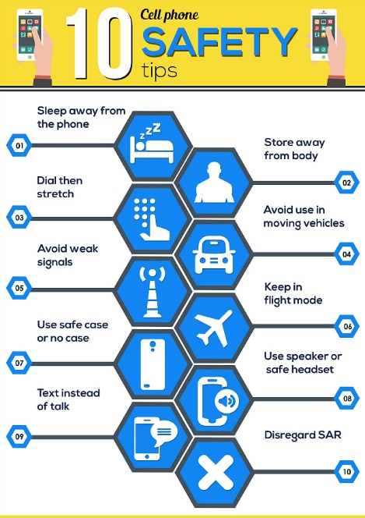
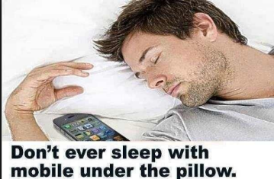
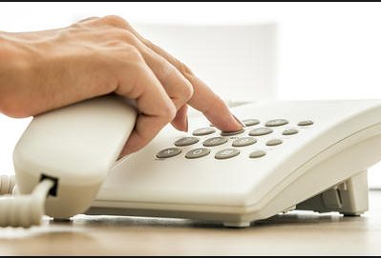
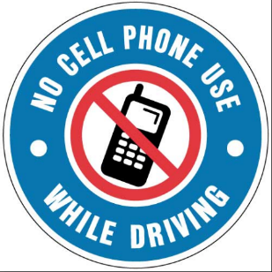
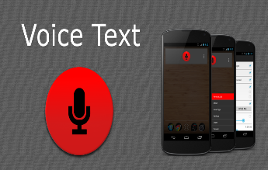

Slide 5
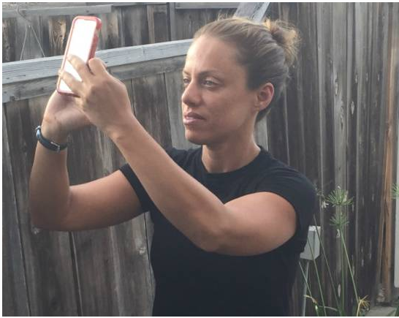
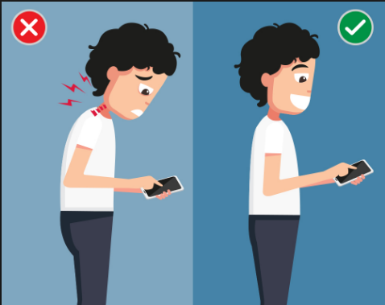
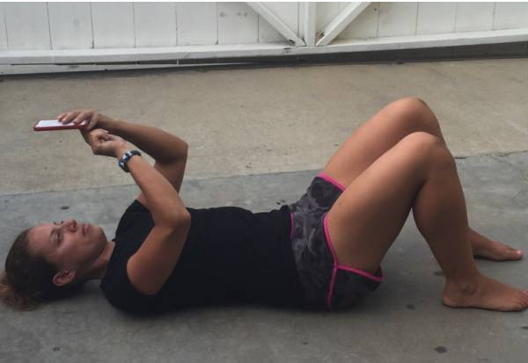
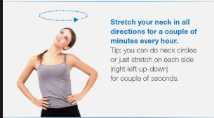
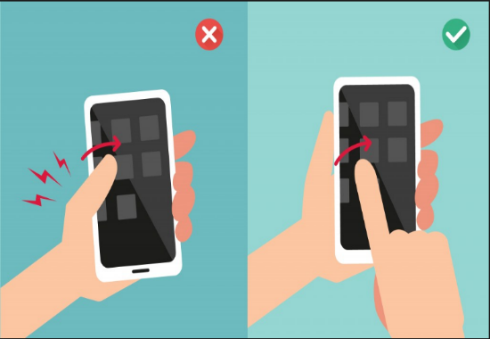
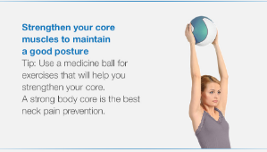
What You Can Do to Avoid the Slump

Slide 6
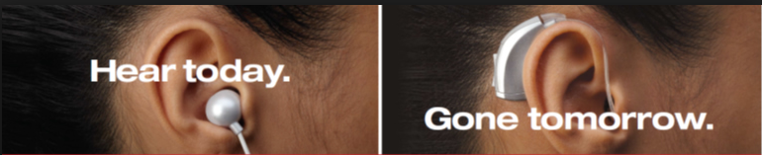

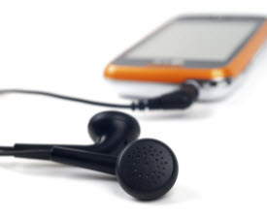
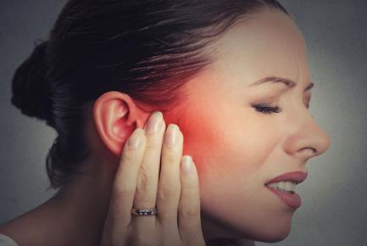
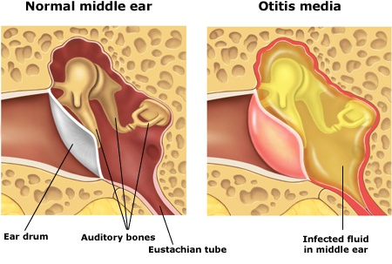
Hearing loss/ Hearing complications
Ear Infections
No air passage
Numb Ears
Pain in Ears
Bad effects on Brain
Life Threatening Accidents

Slide 7
Avoid using tiny headphones/earphones that directly go into the ear canals. Better those big headphones, the old ones which stay outside your ears.
Avoid sharing your earphones/headphones with others.
Make sure you change the sponge cover/ rubber cover of your headphones/earphones once a month. If your earphones/headphones doesn’t have sponge covers, make sure you sanitize them.
Do not use earphones/headphones when you are travelling by car, train, metro or even walking.
No loud music ever when you use earphones/headphones

Slide 8
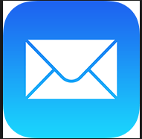





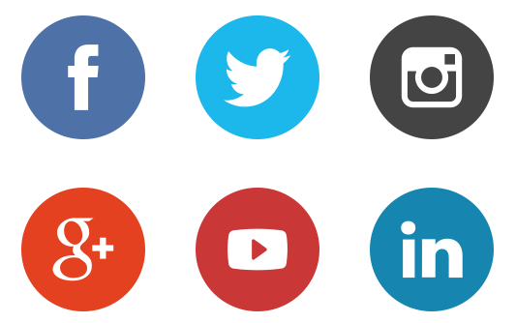
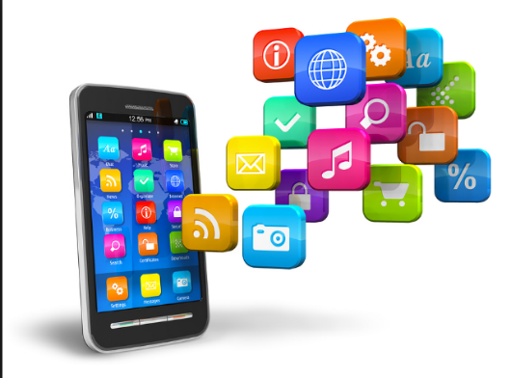

Mobile apps and uses

Slide 9


Apps Stores
Google Play Store for Android phone
App Store for iOS phone
Store on Windows phone
OVI suite for Nokia phone

Slide 10
Don’t commit phubbing
Don’t answer your phone in the movie theatre
Use a normal tone of voice while speaking on your cell
When you are in public places, keep your distance
Don’t use your speaker phone in public

Slide 11

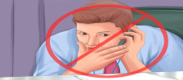


Don’t look things up on your phone while you are talking with someone on that same phone
When you’re on the job/study, keep your phone away
Don’t use your phone when having a meal with someone
Avoid texting or talking on your phone when you are having a face-to-face conversation

